Slide 3
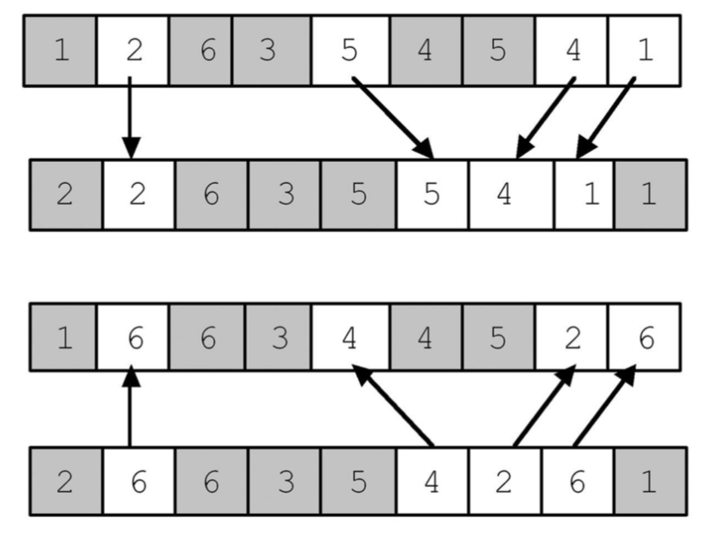
Parent 1
Child 1
Child 2
Parent 2

Slide 4
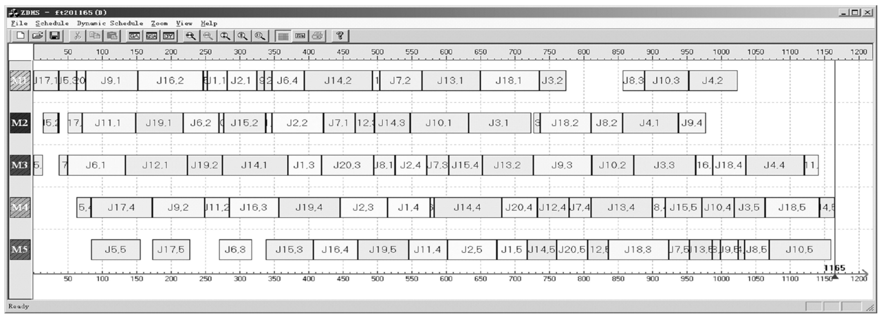

Slide 5
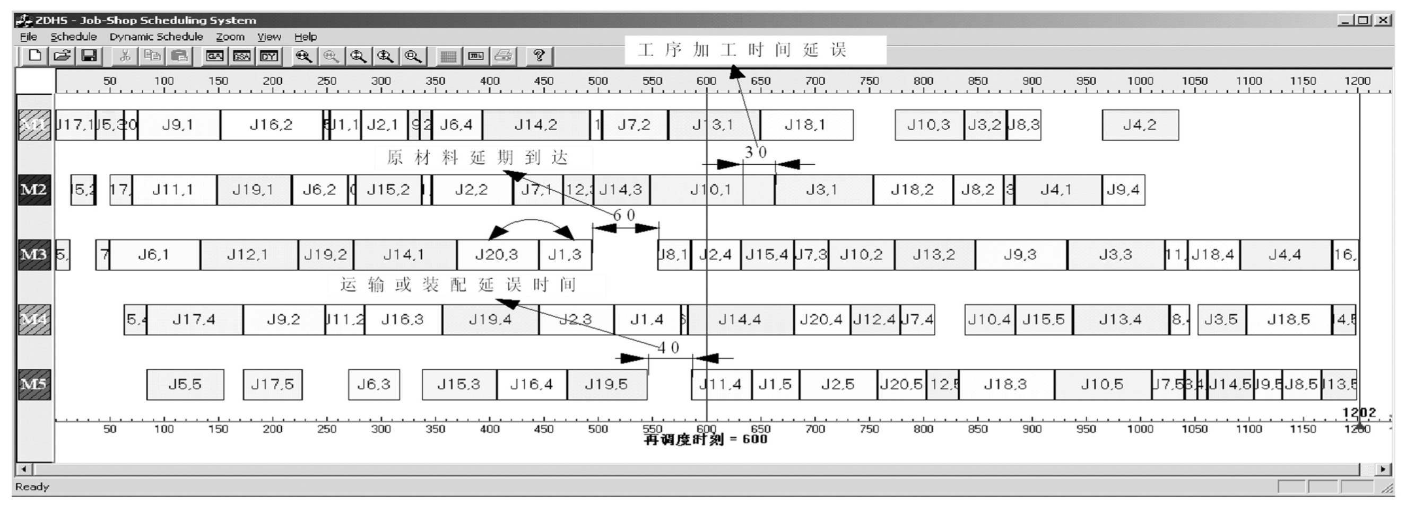
Delay of job processing time
Delayed arrival of raw materials
transportation or assembly delayed time units
Rescheduling time = 600

Slide 6
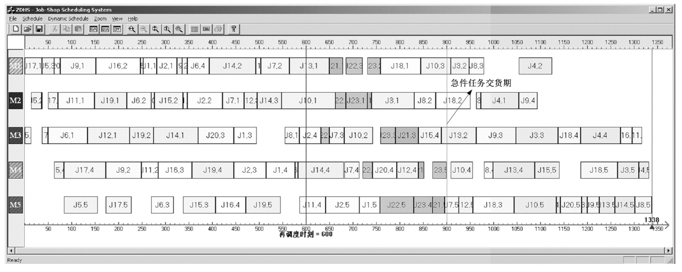
Urgent job delivery time
Rescheduling time = 600

Slide 8
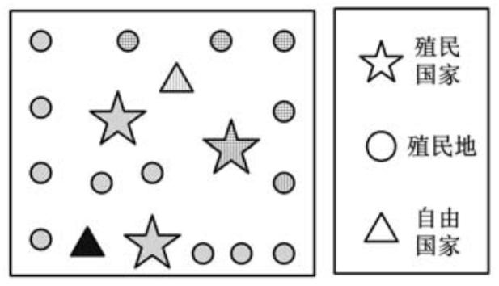
Empire
Colony
Independent Country

Slide 9
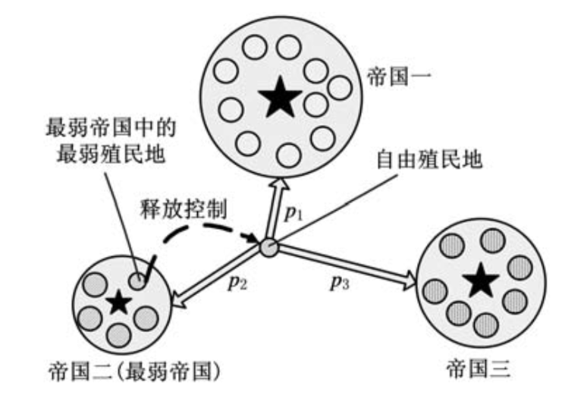
Empire no. 1
Weakest colony with weakest empire
Free colony
Free control
Empire no. 2 (weakest empire)
Empire no. 3

Slide 10
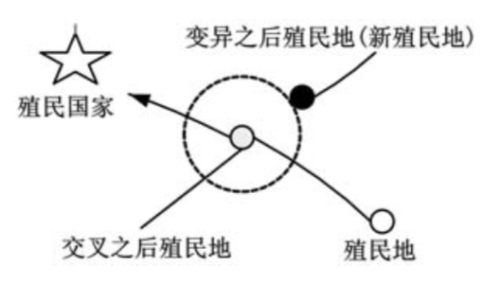
Colony after mutation
Empire
Colony after crossover
Colony

Slide 11
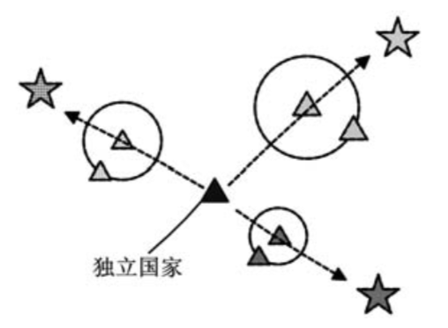
Independent country

Slide 12
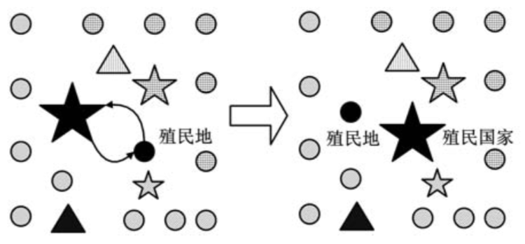
Colony
Colony
Empire

Slide 13
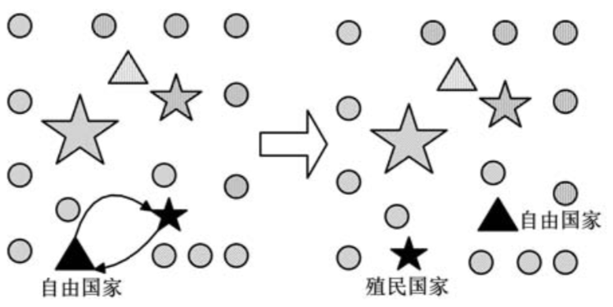
Independent country
Independent country
Empire

Slide 14
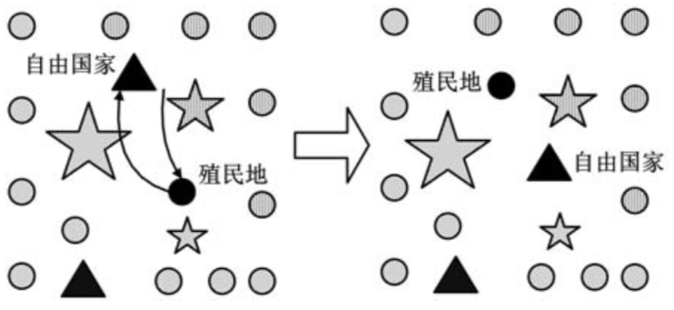
Independent country
Colony
Independent country
Colony

Slide 16
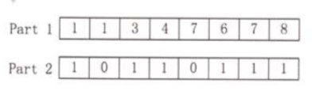

Slide 17
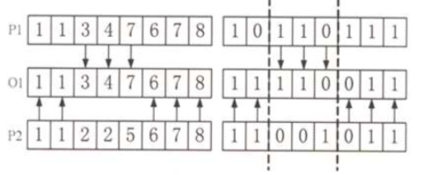

Slide 18
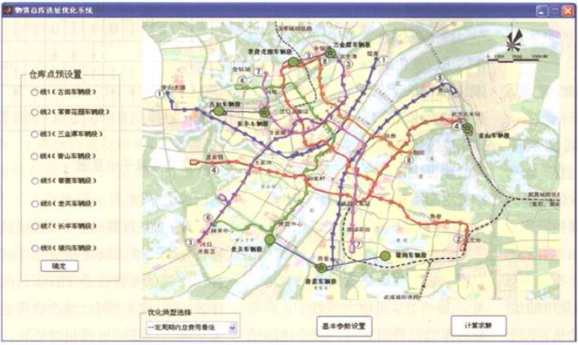
Warehouse facility optimization prototype
Car depot
Car depot
Potential locations
Rail lane 1
Car depot
Rail lane 2
Car depot
Rail lane 3
Car depot
Rail lane 4
Rail lane 5
Rail lane 6
Rail lane 7
Rail lane 8
Car depot
Car depot
confirm
Car depot
Optimization Type
Minimize total cost within planning period
Parameter settings
Solve

Slide 19
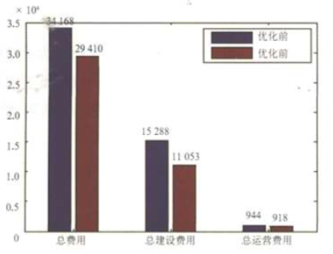
Before Optimization
After Optimization
Total cost
Construction cost
Operational cost

Slide 20
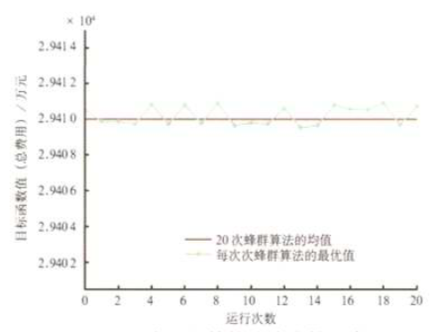
Fitness value (total cost) in 10,000
Average value from 20 runs
Best value from individual run
Run times

